Slide 1

José Antonio Prieto

Slide 2
Introduction to Fog of War
Terminology.
What is Fog of War, on videogames.
For what is used.
Hide selected information to the player.
Notes:
El concepto de fog of war proviene del ambito belico, se relaciona con la polvareda e impedimento de las comunicaciones durante el despliegue terrestre, de la sensacion de incertidumbre del campo de batalla.

Slide 3
Why we need visibility mechanics
Incentive the player to uncover and explore the world.
Implement more realistic uncertainty on game world.
Promote more depth and strategic gameplays.

Slide 4
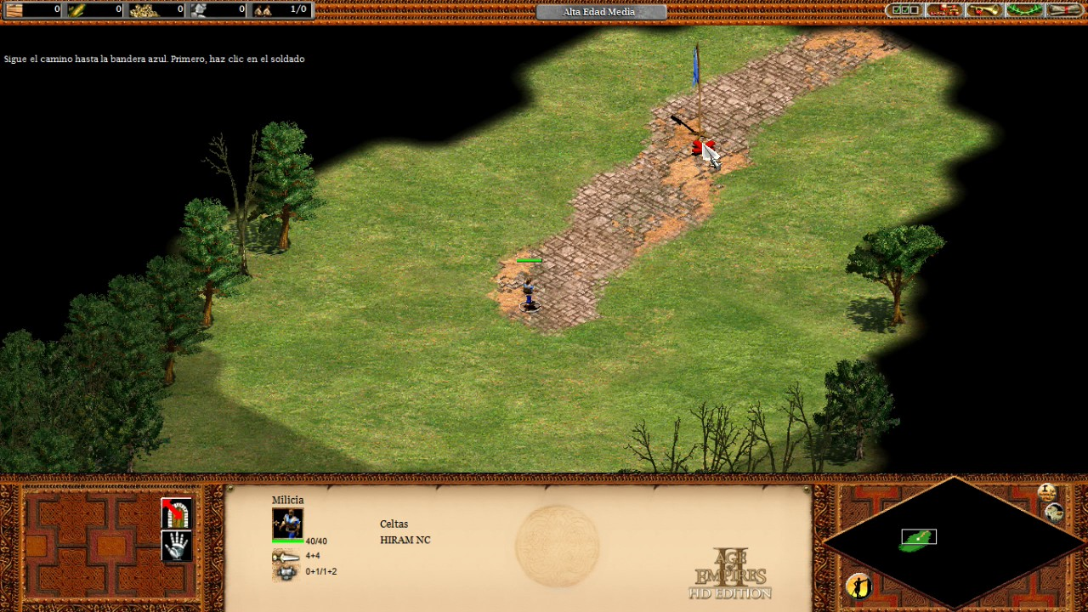
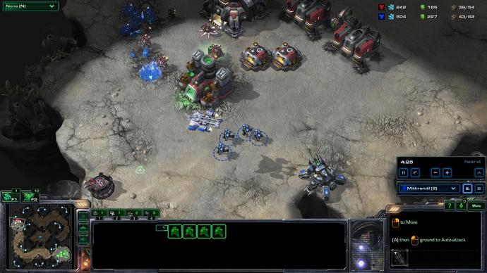
Quick examples of games that uses it
Notes:
explicar las diferencias del clasico rts con shrod, al moderno que suele prescindir de el.
league of legends, sin shrod, wards

Slide 5
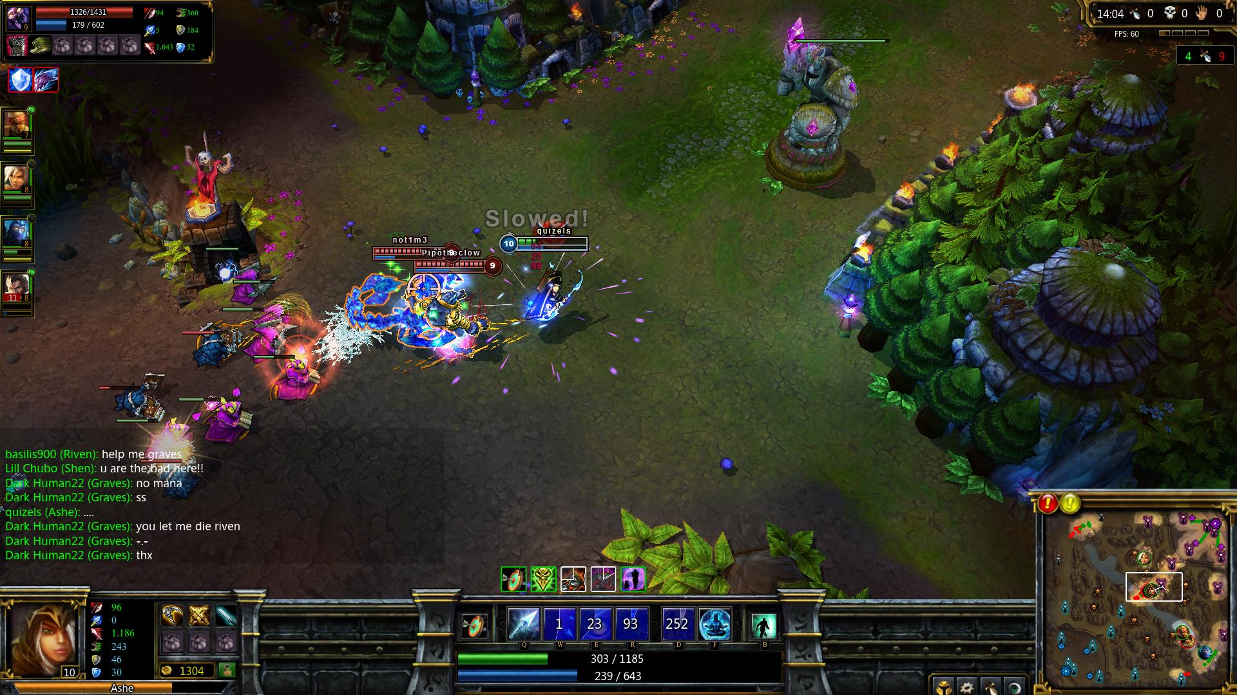

Slide 6
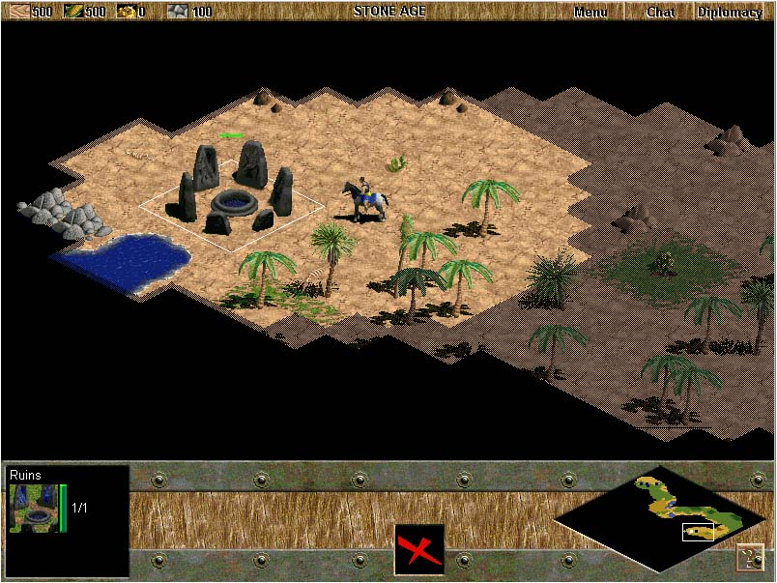
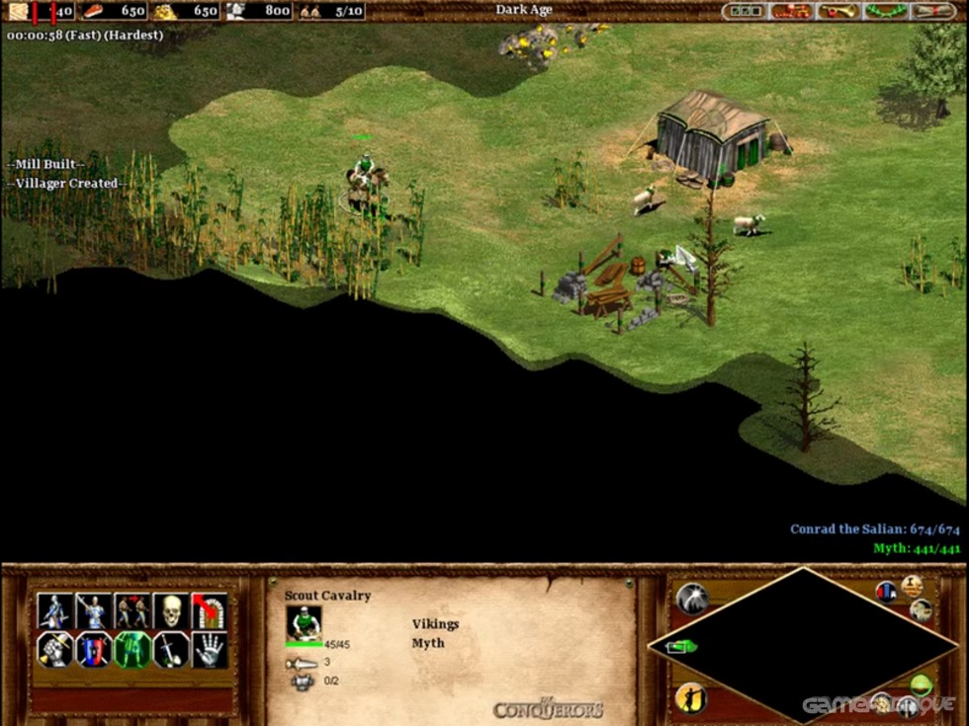
Types of Fog of War
Notes:
chunky: bordes duros, mas sencilla implementacion, solo array de boleanos o enumerator.
smooth: mayor complejidad, mayor consumo de recursos, distinta implementacion
depende del tipo de juego o graficos que usemos, de los recursos de los que dispongamos, elegiriamos uno u otro. La perspectiva es indiferente, al igual que la profundidad 2d o 3d.

Slide 7
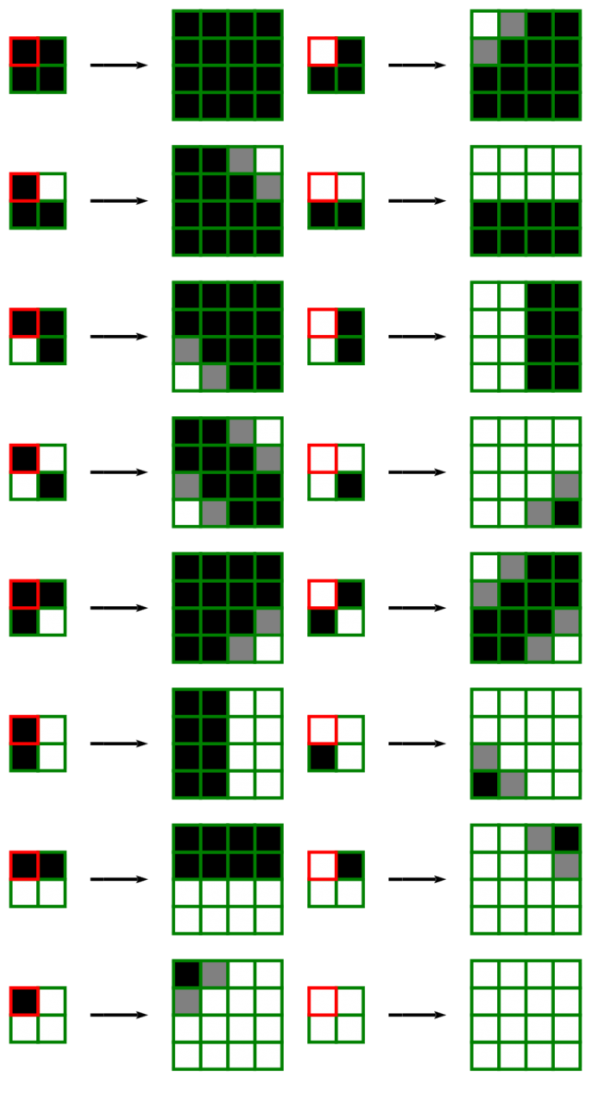
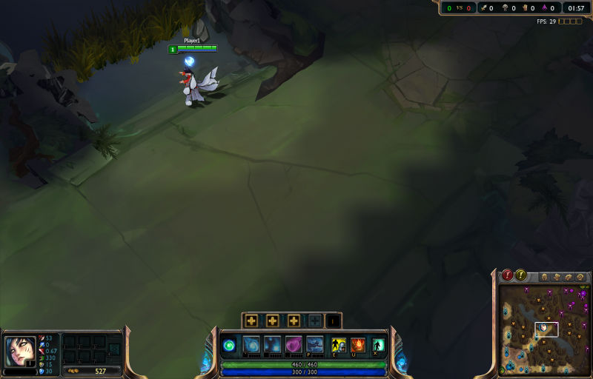
Quick look to some approaches
Riot Games - From Tile-grid to texture
Notes:
cuando renovacion nuevo diseño de mapa, problema de jagged edges, resolvieron con un upscaling custom con estas 16 posibilidades, lo que les permitia luego aplicando un blurr un acabado suave.

Slide 8



128x128 Fow(4x zoomed)
512x512 Fow (4x upscaled)
512x512 (4x upscaled + blurred)

Slide 9
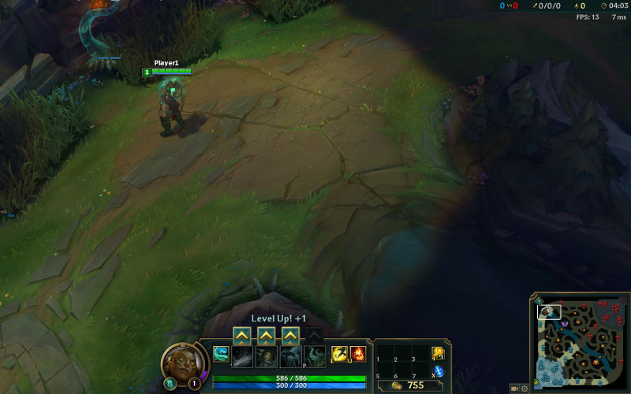

Slide 10
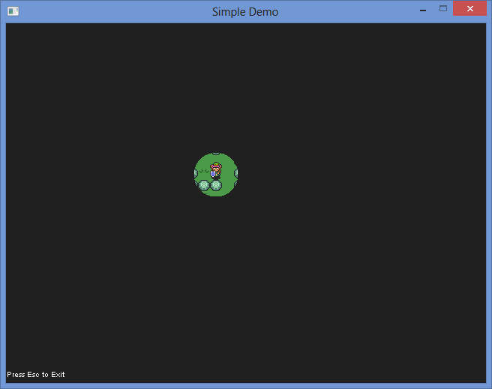
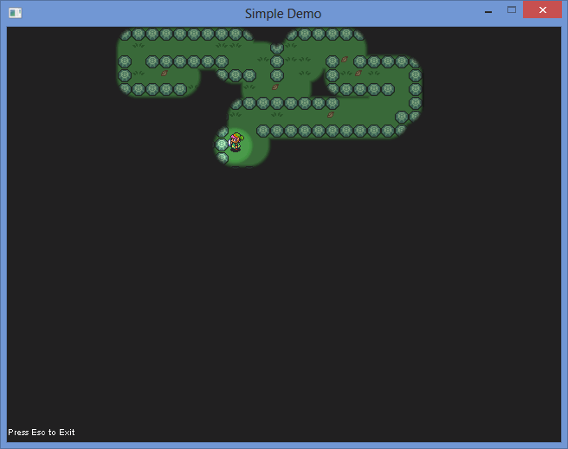

Paint texture with alpha bitmap mask

Slide 11
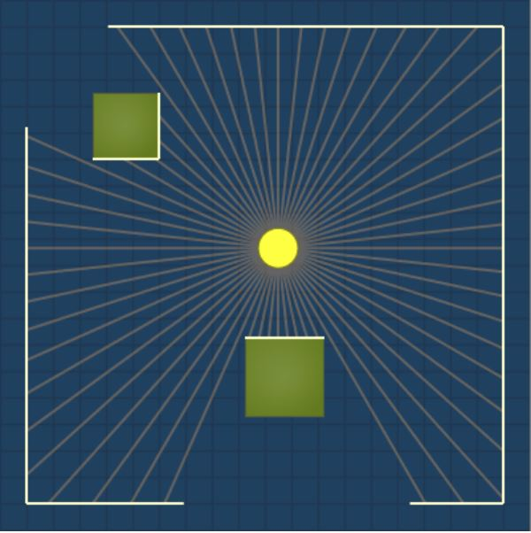
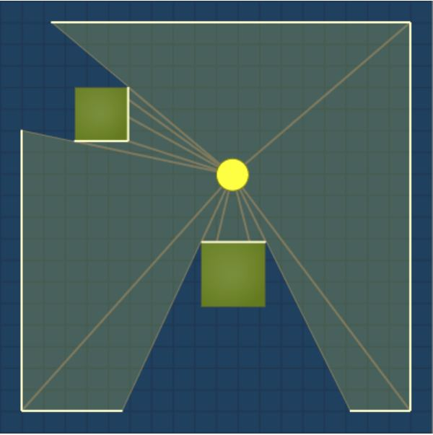
Fast mention to other visibility type - raycast

Slide 12
Selected Approach
Tile-grid from tile based map.
Similar in concept to the Riot approach.
Using bitwise compound operators to perform bitmasking.
(left shift: <<, and bitwise And: &)
Add more players with mouse left click.
Add wards with mouse right click.

Slide 13
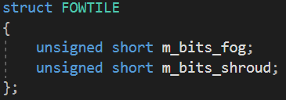

Fog of War tile structure
We have a fog data map, similar to pathfinding with its walkable tiles, but this time for fog information.

Slide 14
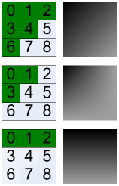
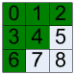
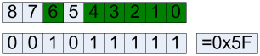
Sub-pixel of bits concept

Slide 15
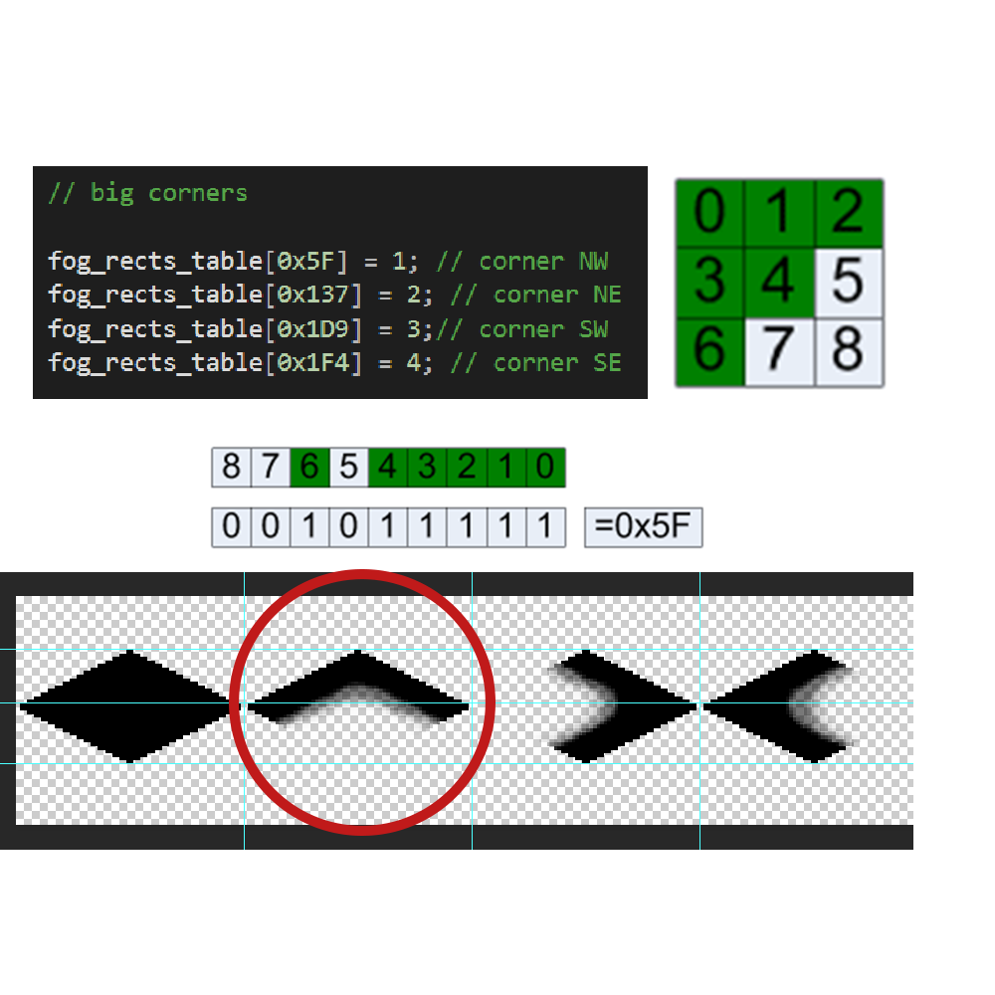
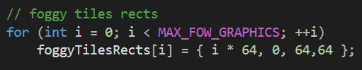
The mapping table stores all possible entries, for a 3x3 matrix, we have 9 bits, what is the same of 512 entries!
We only define what we need/want, mostly all entries are “undefined”.

Slide 16
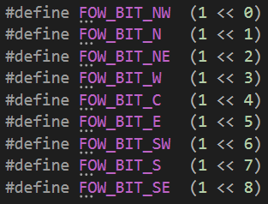
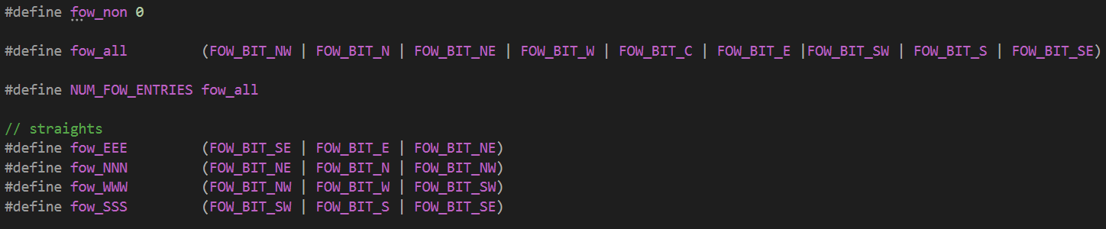
Bit definitions
Improve readability.
Allow us to create the “shape masks” more identifiable.

Slide 17
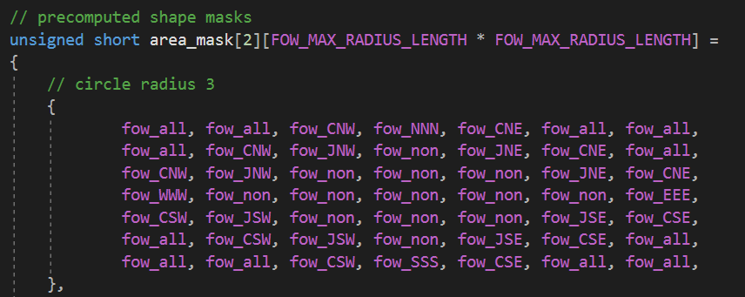
Shape masks
You are not constrained to the shape itself, in this case is a “circle” mask, but you can define what you want.

Slide 18
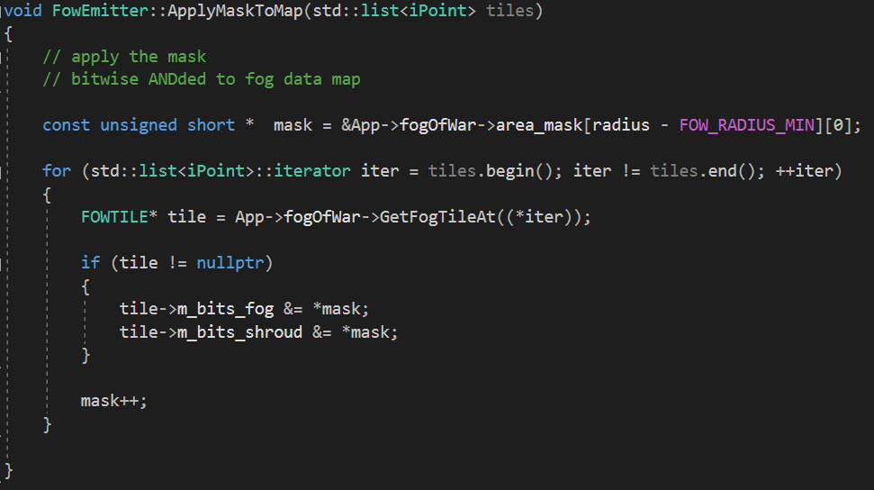
Apply the masks to our fog data map
Get potentially affected tiles
Apply the mask

Slide 19
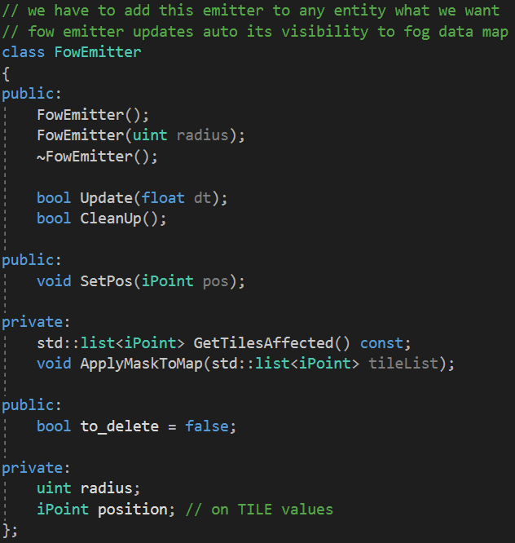
New module
New module j1FowManager to manage a new class FowEmitter.
FowEmitter provides visibility to desired entities.
We need to define a FowEmitter on this entities.
Update its position if needed.

Slide 20
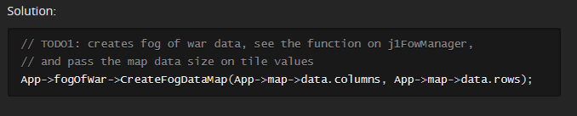
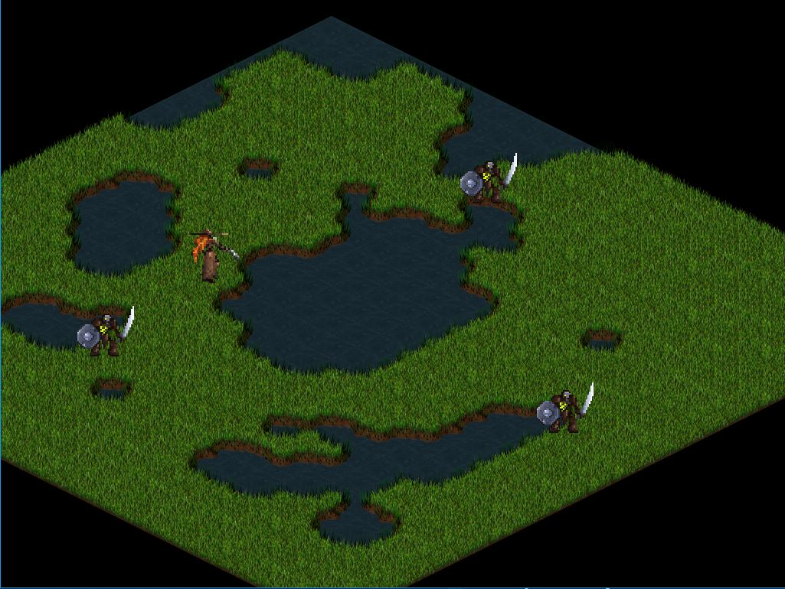
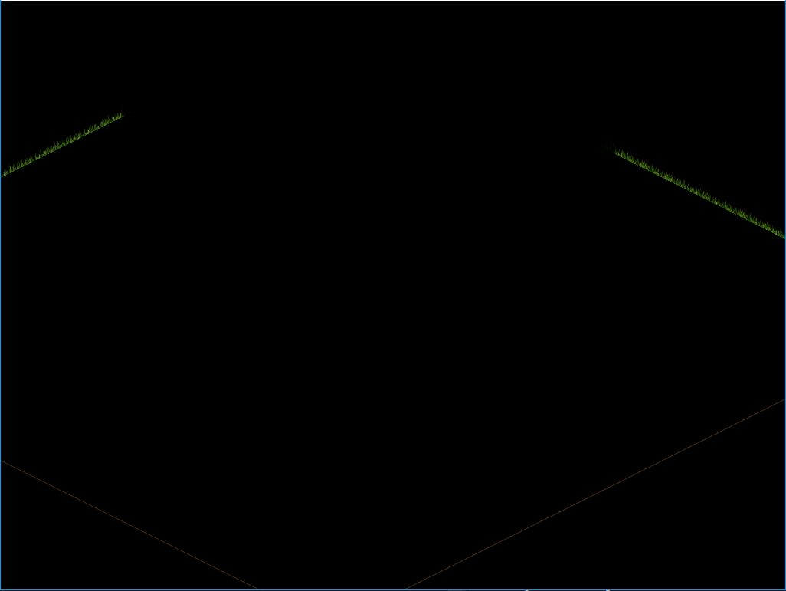
TODO’s Time!
TODO 1
In order to create a valid Fog data map filled with needed data to compute our fog, we need to create it first.
Before Todo1
Expected

Slide 21
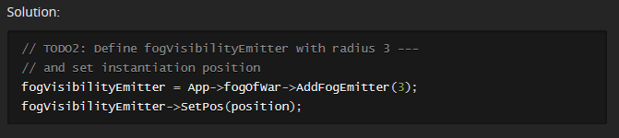
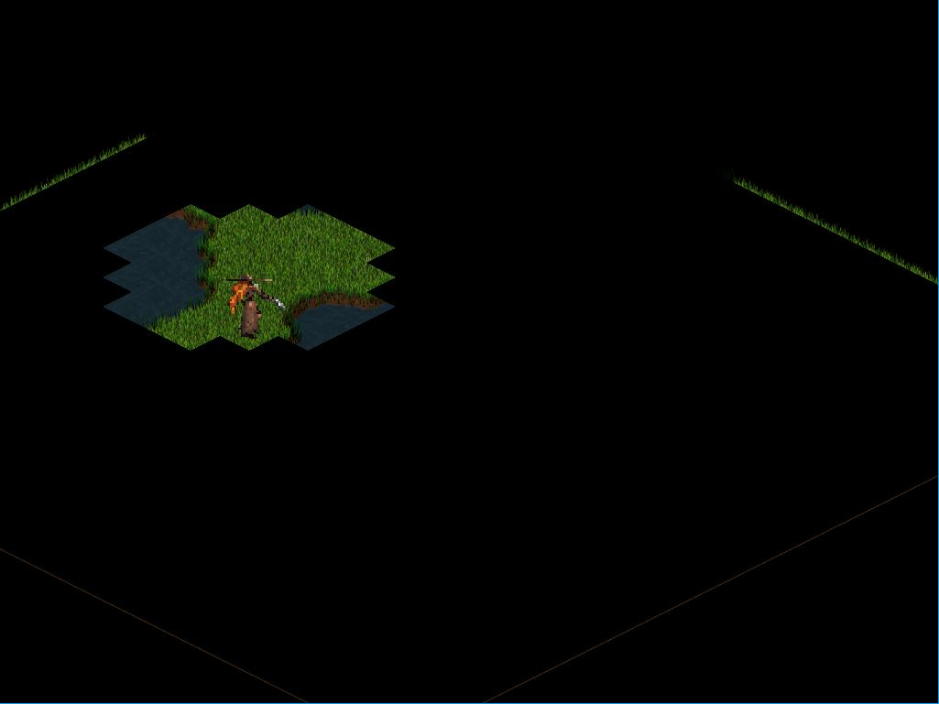
TODO 2
We need to define our fogVisibilityEmitter in our player constructor since we need that players provides us a visibility.
Expected:

Slide 22

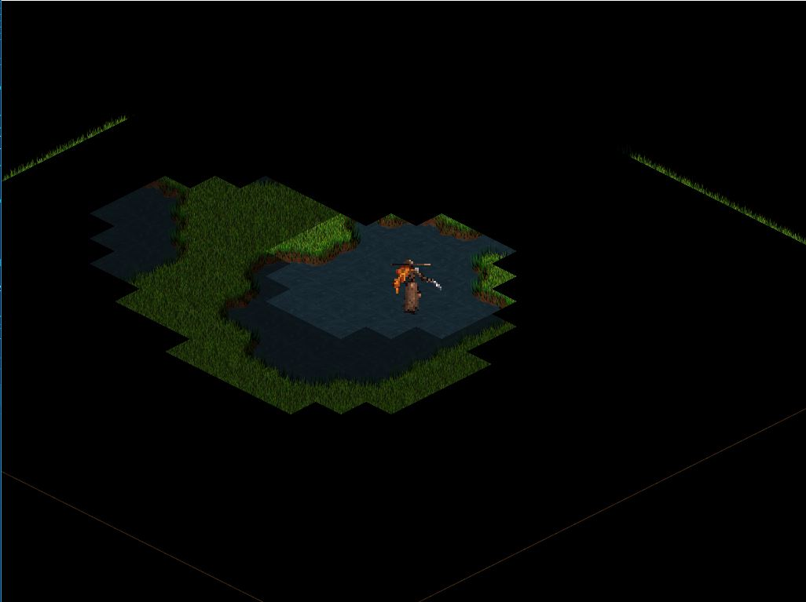
TODO 3
If we want that visibility to follow the player, we need to update its position.
Expected:

Slide 23
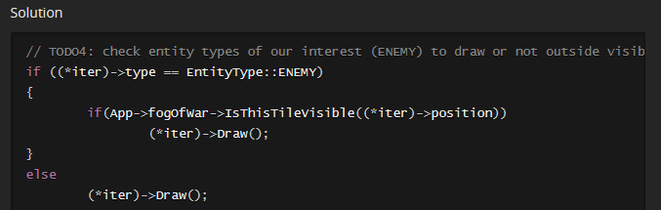
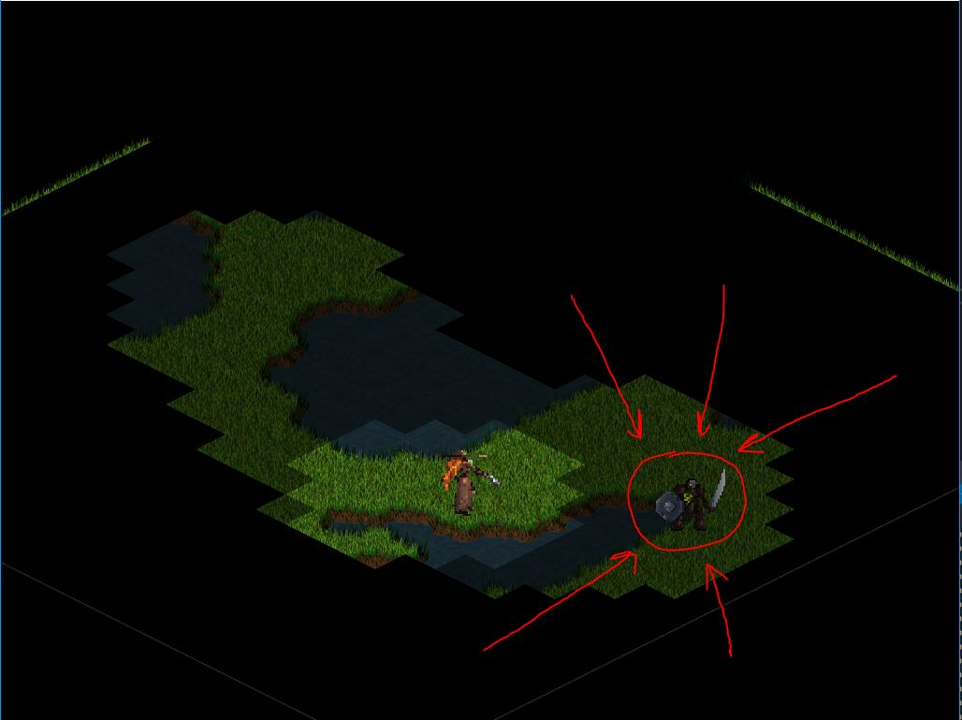
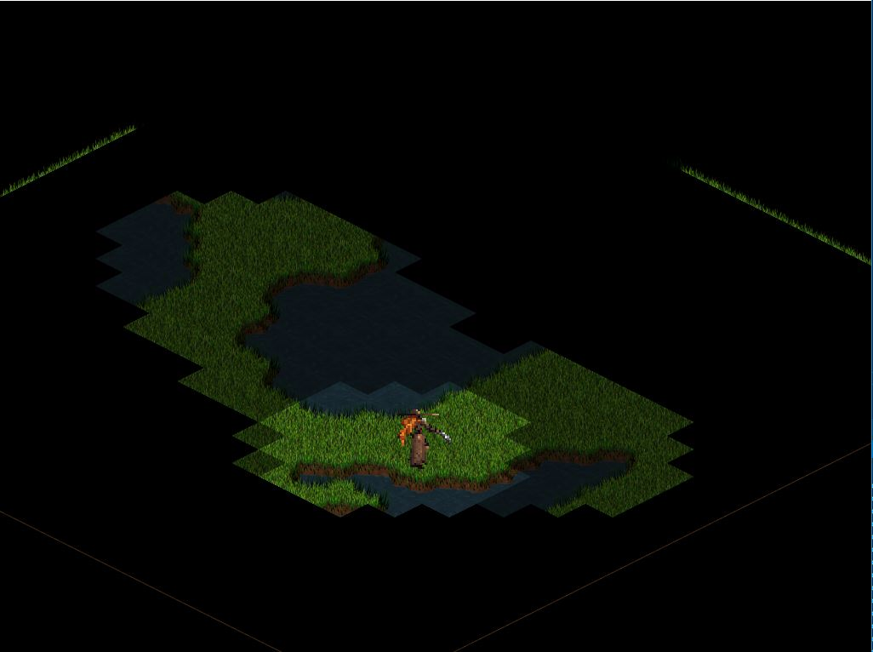
TODO 4
Since we want a visibility mechanic, we need to filter what entities are drawn or not outside player sight radius.

Slide 24
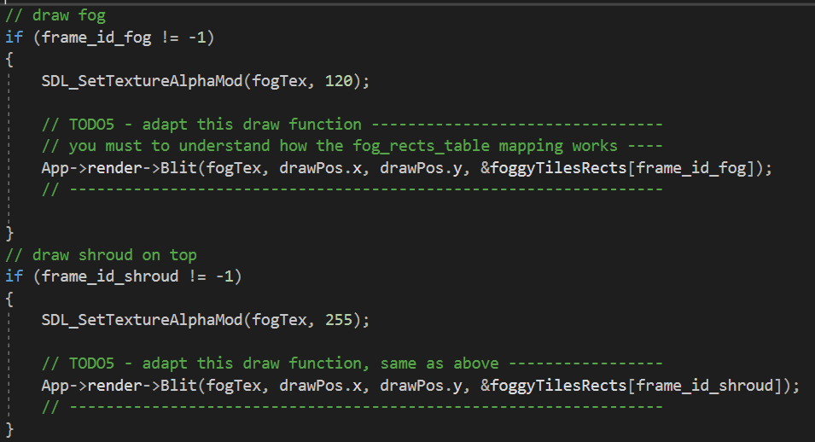
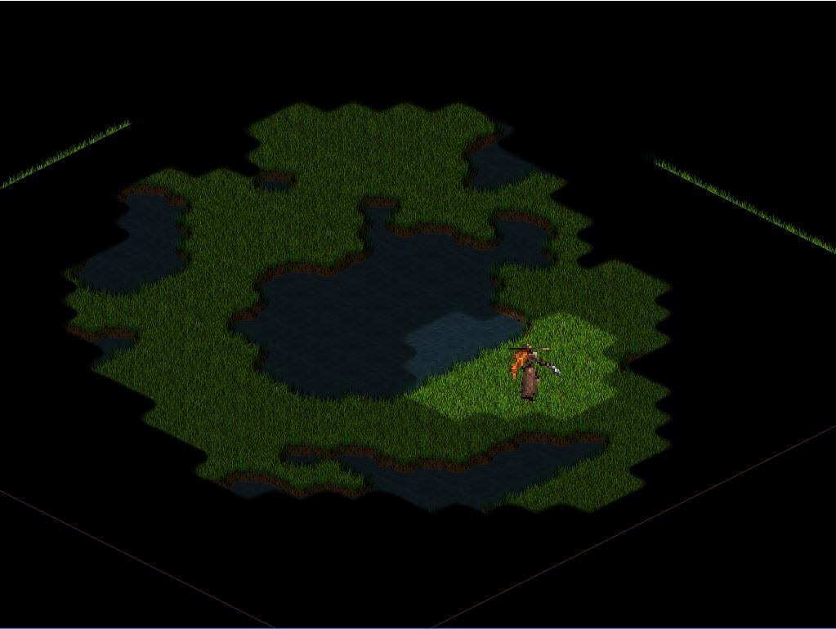
Solution
TODO5, and last!
You need to do the last step inside j1FowManager, adapt the draw function to get the correctly mapped values to our foggyTilesRects array that stores the correct rects for any smoothed graphic.
: )

Slide 25
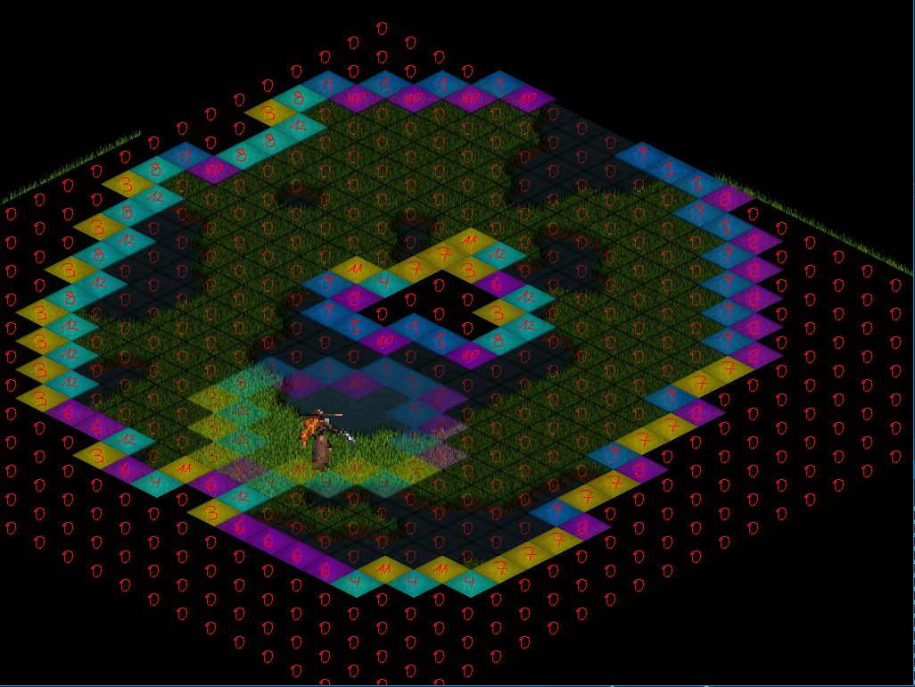
Don’t forget to test debug functionality with F1
May help you to better understand how the underlying works.

Slide 26
Improvements
The fog layer doesn’t needs to be updated on every frame.
The visibility can be occluded through certain types of tiles.
Make more table_rects permutations! (and graphics)
Play with the dimensions of fog “tiles”, doesn’t need to be the same as tilemap!
If you have a huge map, maybe a some type of draw sorting/culling are needed.

Slide 27
Thanks for your attention!
Contact: jpg_2001_@hotmail.com
Github : peterMcP
https://petermcp.github.io/FOW-research/

